Slide 1
Initial Design Concepts
Alpha Cat
12 interesting ideas

Slide 2
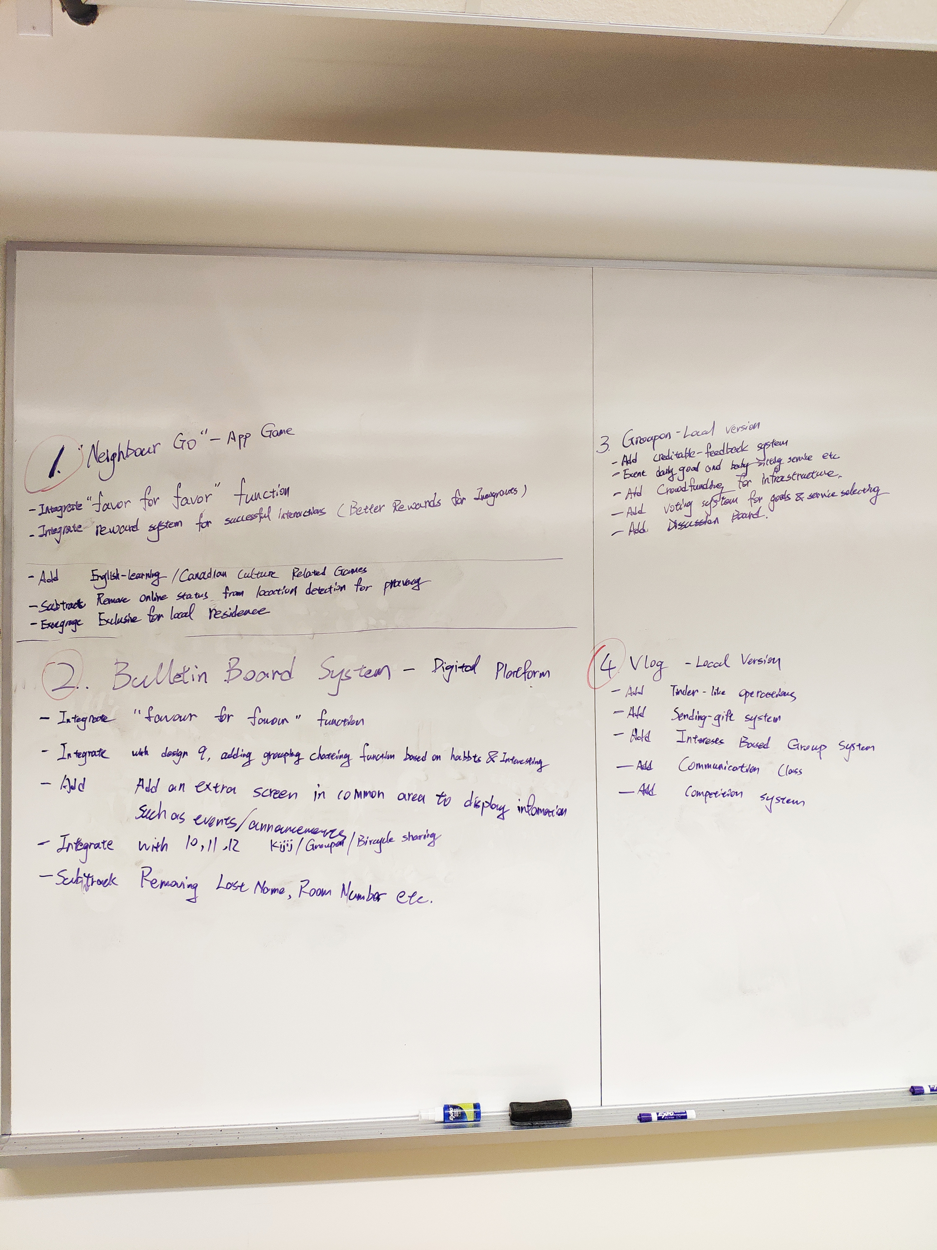
Variation

Slide 3

Digital Forum
#6
Vlog
#1
Community members can upload recorded videos or stream to share their lives
Neighbor GO
#5
A discussion board for people to post their requests or start events, exchange favor and information
Community members are players in a AR-RPG game where they meet new people and form groups for further interaction

Slide 4
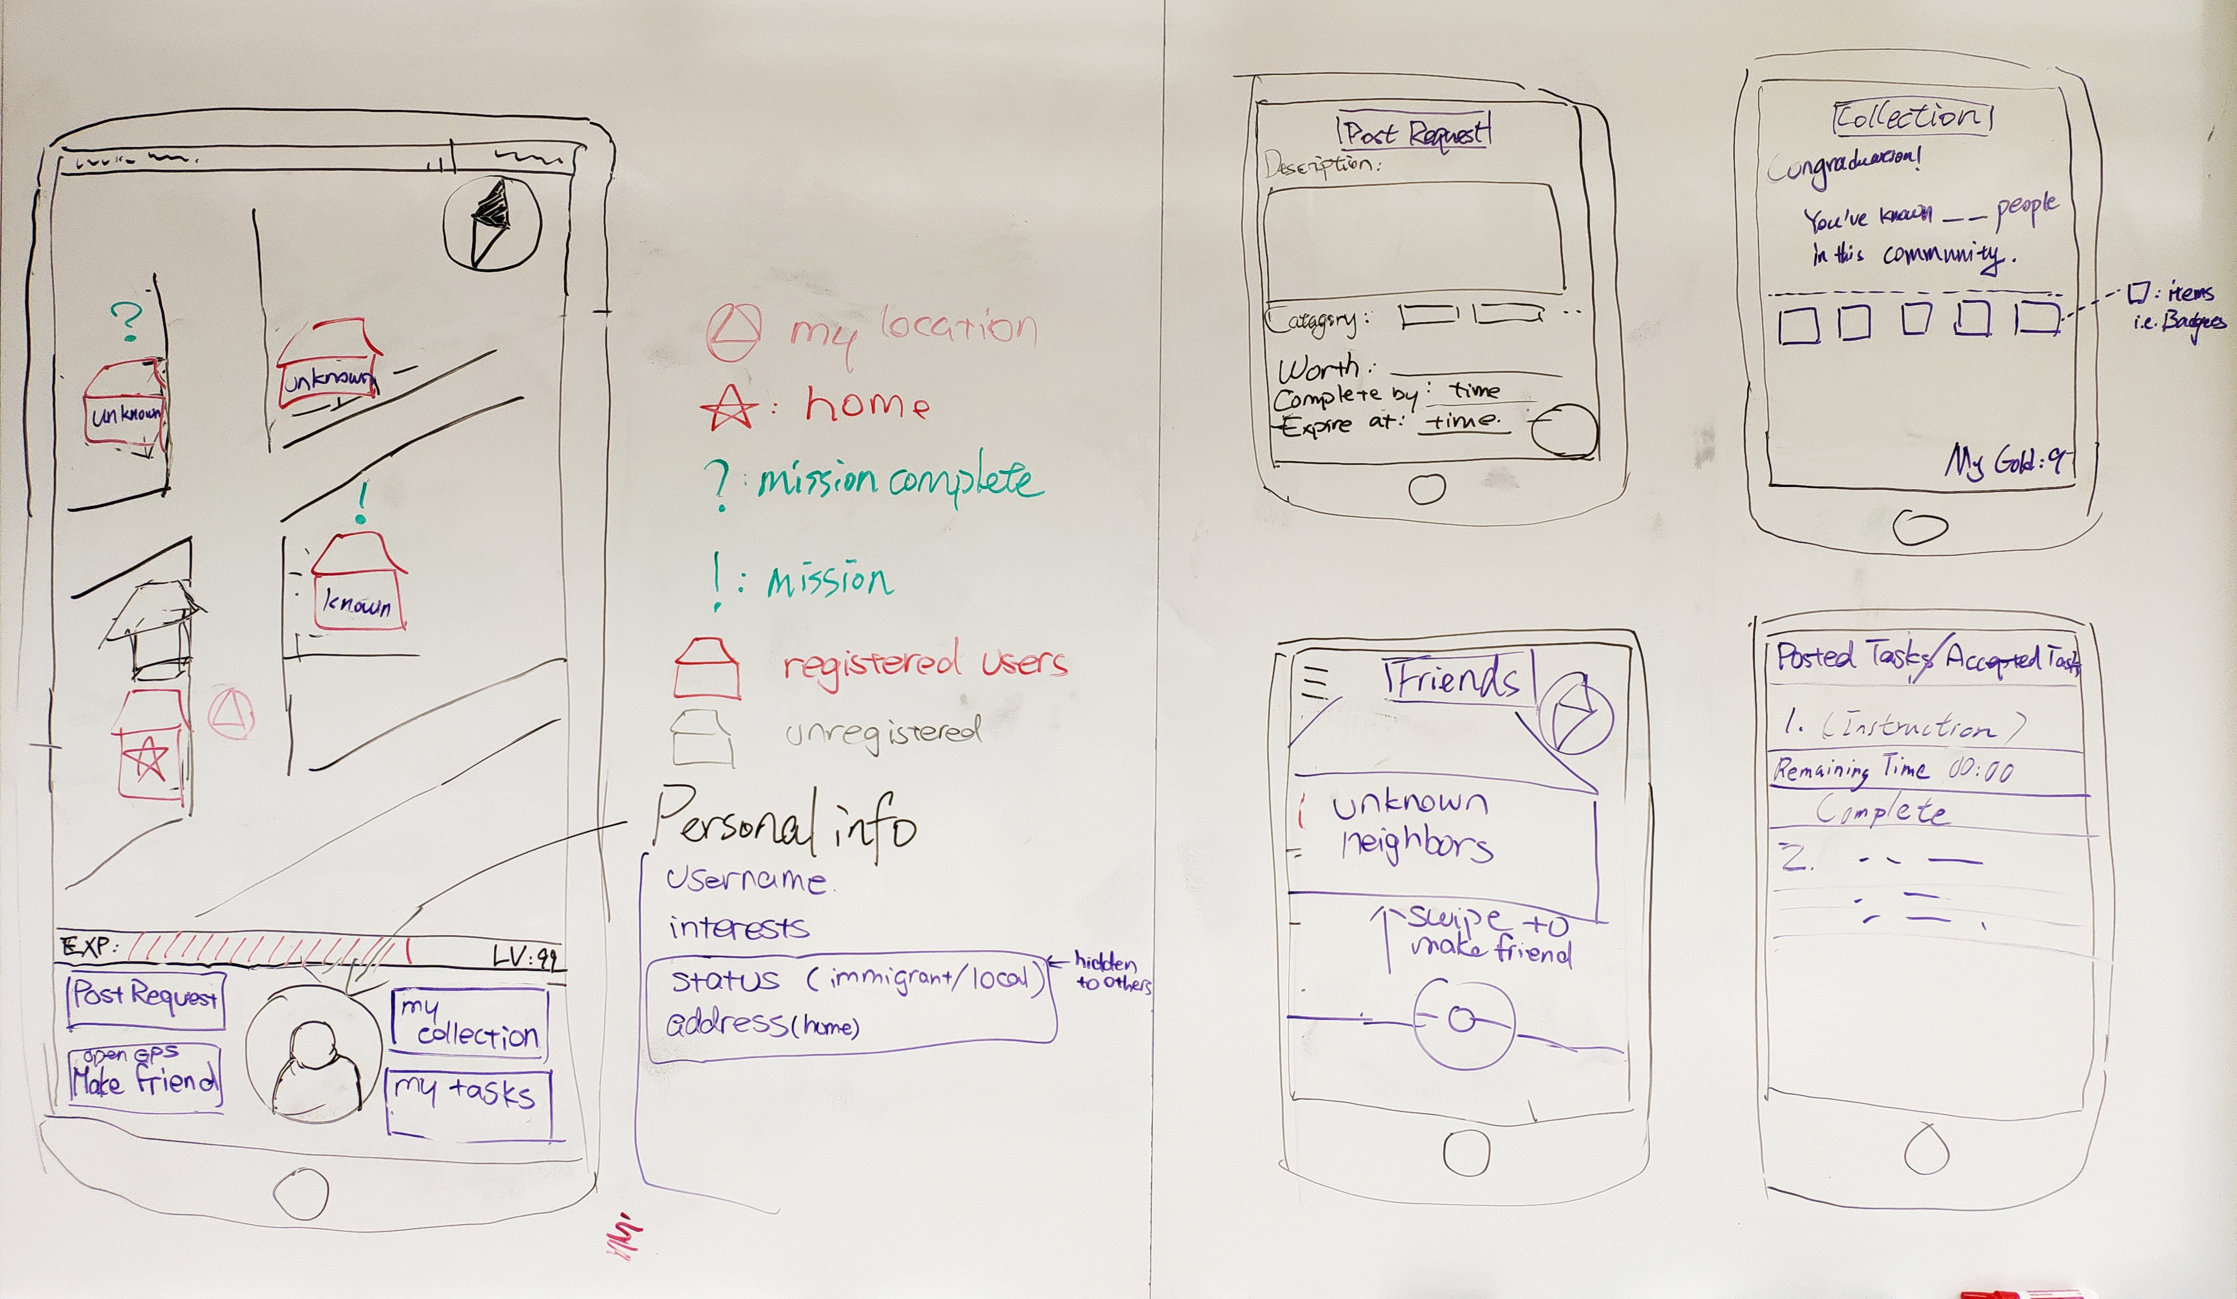
Refined Design Concept

